Slide 1

TRICS DATA COLLECTION IN 2022/23
& AN UPDATED APPROACH TO
TRICS SAM SURVEYS
STEVEN SHAW, WEST SUSSEX COUNTY COUNCIL
Notes:
In this presentation I am going to provide an update on the TRICS data collection programmes for 2022 and 2023 and will also provide some important information on our revised approach to collecting travel plan information for commissioned SAM surveys, following a consultation and redesign this year.

Slide 2
2022: ANOTHER BUSY TRICS DATA YEAR
239 Regional TRICS surveys in the 2022 data collection programme.
All 17 TRICS regions included.
115 multi-modal surveys.
Regional surveys split between Spring and Autumn windows.
Notes:
2022 has been another busy year for TRICS surveys, on a par with the very busy year we had in 2021 (which was most welcome following the gap in surveys due to their suspension for large parts of 2020). This year., we have been undertaking 239 regional surveys across all 17 TRICS regions of the UK and Ireland. This is our annual data collection programme that we directly manage and deliver to continuously expand the TRICS database. Of the 239 surveys this year, 115 are multi-modal surveys, and the surveys were split between the usual Spring and Autumn windows.

Slide 3
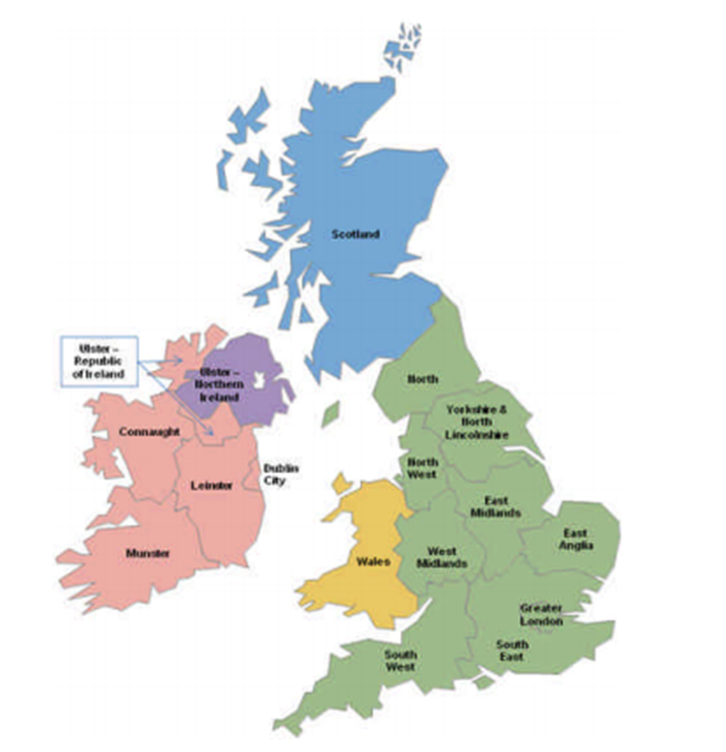
TRICS DATA COLLECTION REGIONS
Greater London Wales
South East Scotland
South West Greater Dublin
East Anglia Connaught
East Midlands Munster
West Midlands Leinster
Yorkshire & N. Lincs Ulster (Ireland)
North West Ulster (N. Ireland)
North
Notes:
To recap on the TRICS regions, you can see them all here, colour-coded for England, Scotland, Wales, Northern Ireland and the Republic of Ireland. As always, all regions were included in this year’s programme.

Slide 4
LAND USE SURVEY BREAKDOWN 2022
Retail: 45 surveys
Employment: 33 surveys
Residential: 55 surveys
Education: 23 surveys
Health: 24 surveys
Hotel Food & Drink: 33 surveys
Leisure: 24 surveys
Other: 37 surveys
Notes:
Here is the main land use type breakdown for the surveys we have been undertaking in 2022. The results of the 2021 TRICS User Survey, as it does every year, fed into our programme, as our users responded listing the land use categories that they would like to see more of in the database. Taking on board all the valuable feedback we received through this method we allocated a proportion of our annual surveys to the main categories. This year Retail has 45 surveys, Employment has 33 surveys, Education has 23 surveys, Health has 24 surveys, Hotel Food & Drink has 33 surveys, Leisure has 24 surveys, and there are 37 surveys allocated to other categories. We also monitored user requests (again through the User Survey) for land use sub-categories, and from this information we formed a list of all sub-categories that have been included in the 2022 programme.

Slide 5
2023: REGIONAL SURVEYS INCREASE
270 Regional TRICS surveys in the 2023 data collection programme.
13% increase on the 2022 programme.
Targets of 120 traffic surveys and 150 multi-modal surveys.
60 of 109 land use sub-categories to be included.
Regional surveys in all regions, split between Spring and Autumn windows.
Notes:
In 2023, the regional data collection programme is going to increase to a total of 270 surveys, which represents a 13% increase on the 2022 programme. We realise that the value of TRICS is its data as well as its functions, and we are always striving to consistently build up the database with as many new surveys as we can, so we are pleased to increase the programme for 2023. Of these 270 surveys, targets are 120 traffic only surveys and 150 multi-modal surveys, and 60 of the 109 TRICS land use sub-categories are to be included. As always, the programme will be split between the Spring (March to June) and Autumn (September to November) survey windows.

Slide 6
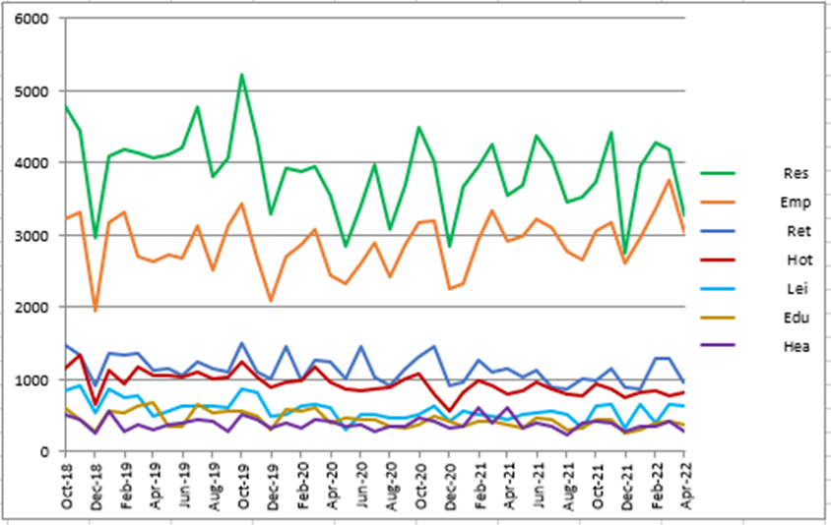
2023: LAND USES REQUESTED BY TRICS USERS
Top 10 preferred land use categories
by users (2022 TRICS User Survey)
  Industrial Unit
  Convenience Store
  Industrial Estate
  Primary School
  Shopping Centre (local shops)
  Warehousing (commercial)
  Retirement Flats
  Fast Food (drive-through)
  PFS with Retail
  Parcel Distribution Centre
Trip Rate Calculations to April 2022
Notes:
The results of the 2022 TRICS User Survey fed into the design of our 2023 data collection programme. As previously mentioned, users are given the opportunity to state their land use sub-category preferences for consideration on the annual programme, and although we are including 60 land use sub-categories in next year’s programme, here are the ten most popular sub-categories as requested by the users in the 2022 User Survey. The image on the right of this slide is one that we regularly use to monitor the level of trip rate calculations undertaken by our users across the 7 biggest main land use types. The most popular main category is Residential, which you can see in green, followed by Employment in orange. In the lower part of the graph you can see Retail, Education, Health, Hotel Food & Drink, and Leisure. This monitoring also assists us in the design of our annual data collection programme.

Slide 7
TRICS SAM SURVEYS IN 2022
2022 another huge year for commissioned SAM surveys following a very busy 2021.
56 surveys commissioned in 2022.
19 of these in Greater London.
Indications that requirements for TRICS SAM surveys in increasing.
Notes:
Moving on to our SAM (Standardised Assessment Methodology) surveys, which are directly commissioned by clients for developments that require multi-modal TRICS surveys to be undertaken as part of travel plan monitoring. 2021 was an extremely busy year for these commissioned surveys, and 2022 has seen this trend continuing. 56 SAM surveys have been commissioned this year, with 19 of these inside Greater London. There are indications that requirements for TRICS SAM surveys are increasing, which of course is a good thing in terms of more data being added to the TRICS database. More information on the SAM process can be found on the TRICS website. We already have further surveys requested for 2023 and preparations are underway for the first of these which will be taking place in the Spring survey window.

Slide 8
BIG CHANGES TO TRICS TRAVEL PLAN SECTION
TRICS Travel Plan data section introduced in 2005.
Travel Plan section originally designed for Non-Residential, but most surveys are Residential.
Some of the section’s “questions” had become outdated.
Travel Plan Working Group formed in 2022.
Notes:
The rest of this presentation is going to focus on a major redesign of the TRICS Travel Plan data section. This additional section of information was first introduced in 2005, to provide a further level of detail explaining a site’s travel plan and its constituent elements. It was originally designed on the thinking that many travel plans would be at employment developments such as offices, etc. However, we have found over time that most SAM surveys are at residential developments. We also had a good look at the “questions” that are within the Travel Plan section and found that some had become outdated to varying degrees. Therefore, it was decided this year that we would undertake a full review of this data section, and the Travel Plan Working Group was formed early this year.

Slide 9
BIG CHANGES TO TRICS TRAVEL PLAN SECTION
Working Group included Consultants, Data Collection Contractors, TRICS Board and SAM Clients.
Consultation exercise took place to review and revise all Travel Plan sub-sections.
Revisions to Travel Plan data section now underway.
All SAM surveys from 2023 onwards will be in the revised format.
Notes:
This Working Group included Consultants, Data Collection Contractors, the TRICS Board and some of our regular SAM Clients. This represented a good mix of people that had an interest in these surveys. A consultation exercise took place to review all sub-sections of the Travel Plan data section, and this was a successful exercise as it led, after some further fine tuning, to a significant overhaul of the whole data section. System development work on this revised sub-section is now underway, and it will apply to all SAM surveys undertaken from 2023 onwards.

Slide 10
TRAVEL PLAN SECTION: KEY CHANGES
Travel Plan data section split between Residential and Non-Residential development types.
Costs of individual travel plan elements removed.
Many data “questions” revised to be more up to date and relevant.
Some new “questions” and data fields added to provide more valuable information and context.
Attendees at this event can now see the first preview of the new screen layouts.
Notes:
Here are the key changes to the Travel Plan data section for all future surveys. Firstly, we will be splitting this section between residential and non-residential development types. This is a very important change, as it allows us to tailor the information towards the relevant development type. One of the main issues we had previously was that many of the questions in this section were aimed towards more non-residential development types, so this should assist us greatly in delivering more relevant information for residential sites. We have removed the costs for individual travel plan elements, as these always proved hard to get and they became impractical data fields in the end. Many of the questions in the section have been revised to make them more up-to-date, some have been removed and new ones have been added. It has been a thorough revision across the board, and we are very pleased with the new format we have ended up with. Attendees at this event can for the first time now see a preview of our new Travel Plan data section screen layouts.

Slide 11
NEW TRAVEL PLAN SECTION
Residential developments from 2023 onwards
Screen layouts of revised Travel Plan sub-sections
Notes:
I will show you the new Travel Plan data section screen layouts in two stages. The first will show the new layouts for residential developments, and the second will cover non-residential developments.

Slide 12
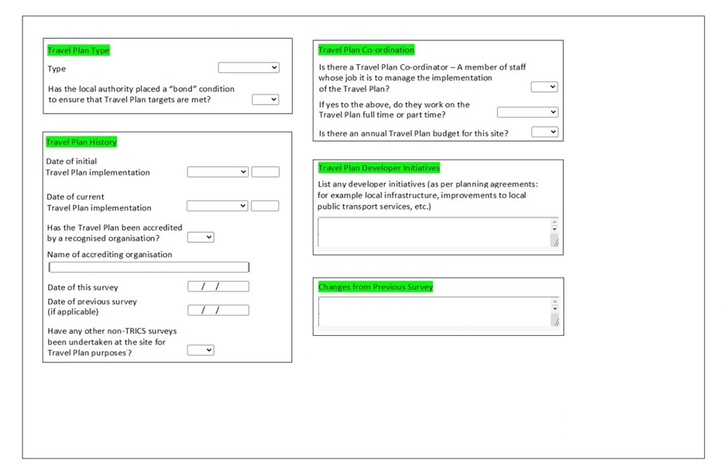
RESIDENTIAL SAM SURVEYS: MAIN DETAILS
Notes:
There are numerous screen designs to show you, but I am not going to dwell too long on each. I would suggest the best thing to do is to examine these layouts once these presentations are made freely available from the TRICS website, which will happen very soon. We may also add them directly to the website as a news item. The screen designs are split into residential and non-residential types. Here is the first revised Main Details sub-section for residential developments. Things to note here are the introduction of dates of previous surveys at the development plus a comments box on Travel Plan Developer Initiatives.

Slide 13
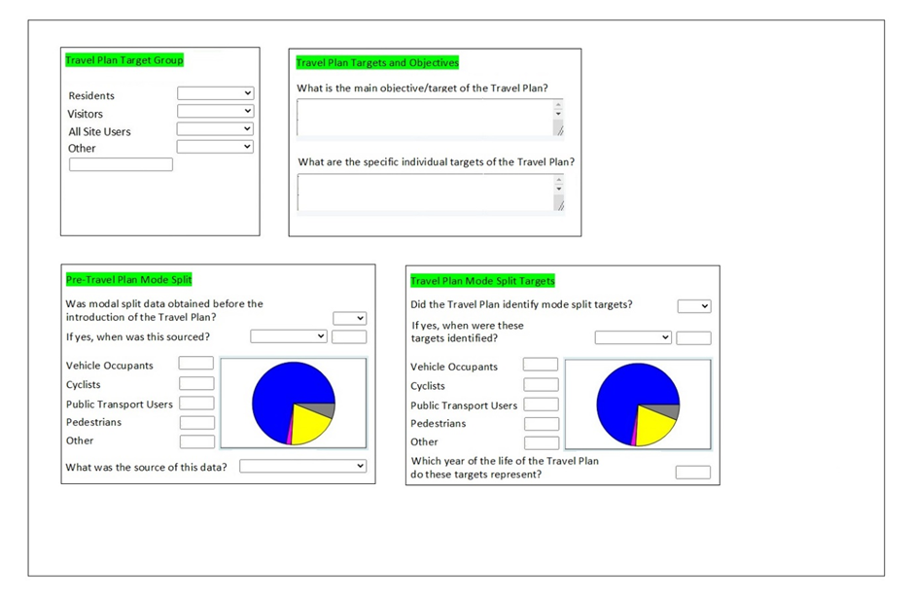
RESIDENTIAL SAM SURVEYS: TRAVEL PLAN OBJECTIVES & TARGETS
Notes:
This is the new Travel Plan Objectives & Targets sub-section for residential developments. You will see that the Target Groups are more directly relevant to residential sites, and objectives and targets have become clearer in separate comment boxes.

Slide 14
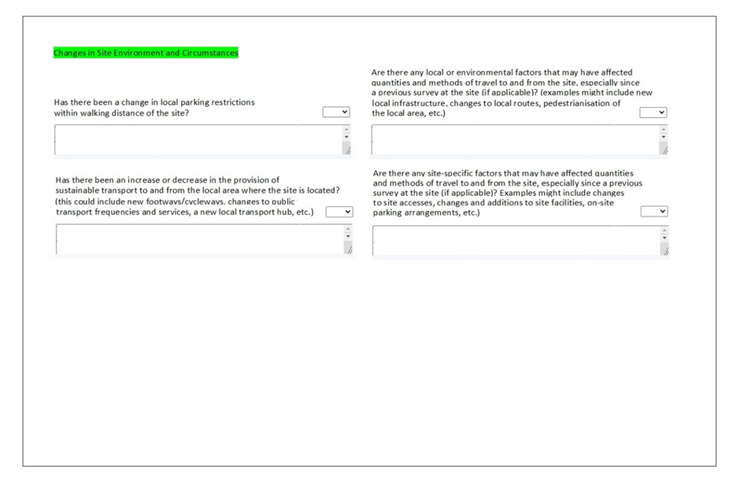
RESIDENTIAL SAM SURVEYS: CHANGES IN ENVIRONMENT & CIRCUMSTANCES
Notes:
Then we have Changes in Environment & Circumstances for residential sites. You can see here that we have provided improved guidance for the various comment boxes relating to the local environment and factors that may influence travel behaviours, etc.

Slide 15
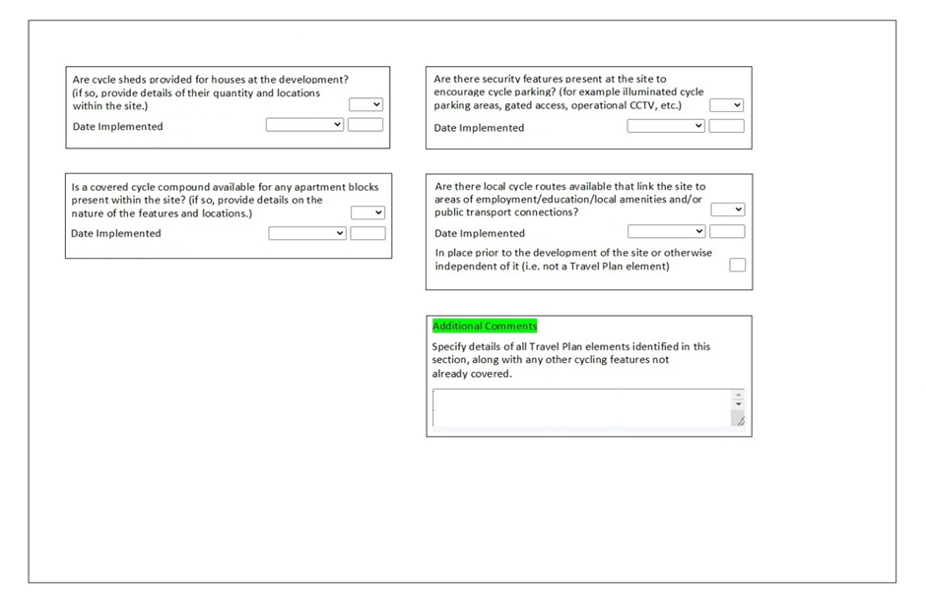
RESIDENTIAL SAM SURVEYS: CYCLING
Notes:
The Cycling sub-section for residential sites is also now more tailored towards residential developments. The wording has been improved and better focused, so that cycle parking provision can be detailed for any residential development in a clear and concise manner. One amendment in particular talks about local cycle routes available that link the site to areas of employment, education, local amenities and public transport connections.

Slide 16
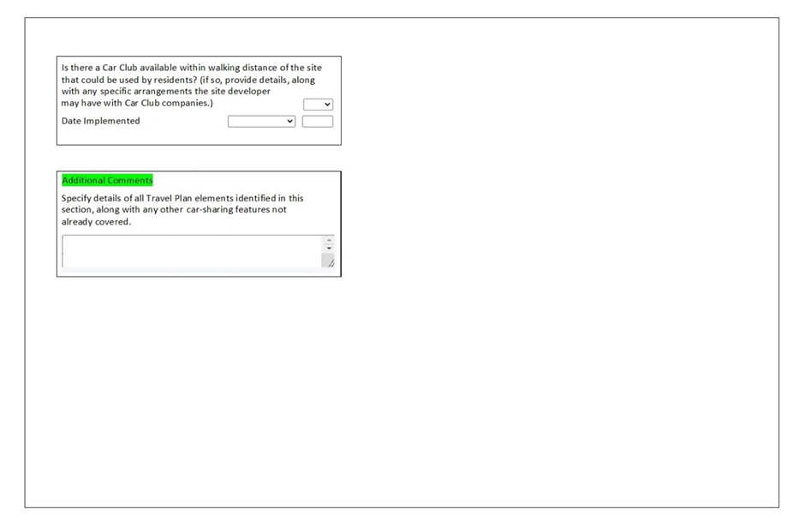
RESIDENTIAL SAM SURVEYS: CAR SHARING
Notes:
The Car-Sharing sub-section for residential sites now mentions car clubs within walking distance of residential sites, along with specific arrangements developers may have with car club companies.

Slide 17
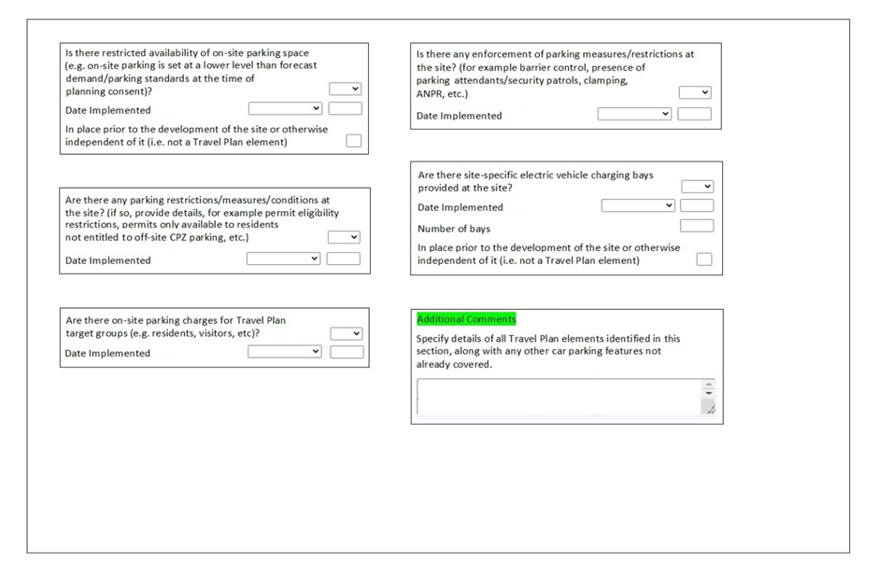
RESIDENTIAL SAM SURVEYS: CAR PARKING
Notes:
The Car Parking sub-section for residential sites has been significantly overhauled. This now includes information on parking charges, parking enforcement measures, and electric vehicle charging bays. This is now a much more relevant section for residential developments that will provide a lot of useful information.

Slide 18
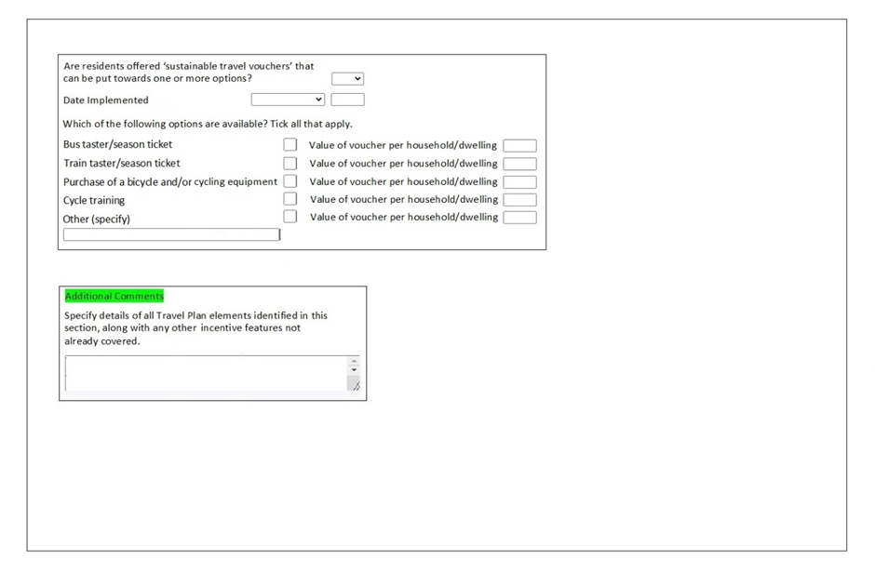
RESIDENTIAL SAM SURVEYS: INCENTIVES
Notes:
The Incentives sub-section for residential sites has a significant new feature included for residential developments. As you can see here, information on “sustainable travel vouchers” is now present, including some options such as bus taster/season tickets, vouchers towards the purchase of a bicycle and/or equipment, cycle training, etc. We have found over time that such features are common for residential travel plans.

Slide 19
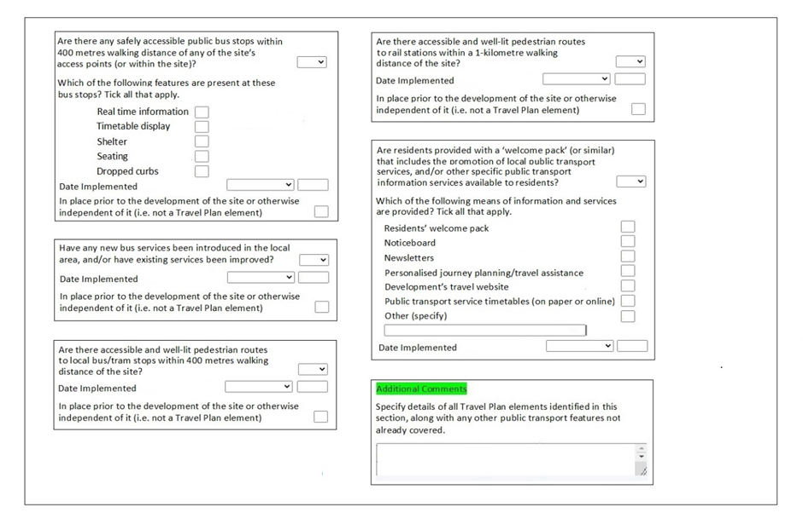
RESIDENTIAL SAM SURVEYS: PUBLIC TRANSPORT
Notes:
The Public Transport sub-section for residential sites has also been significantly overhauled. We have improved and refined information on features at local bus stops and have also introduced a new feature which details resident’s travel packs. Again, this is something we have seen a lot of at residential developments, and now we have a dedicated data item with numerous constituent elements as tick boxes.

Slide 20
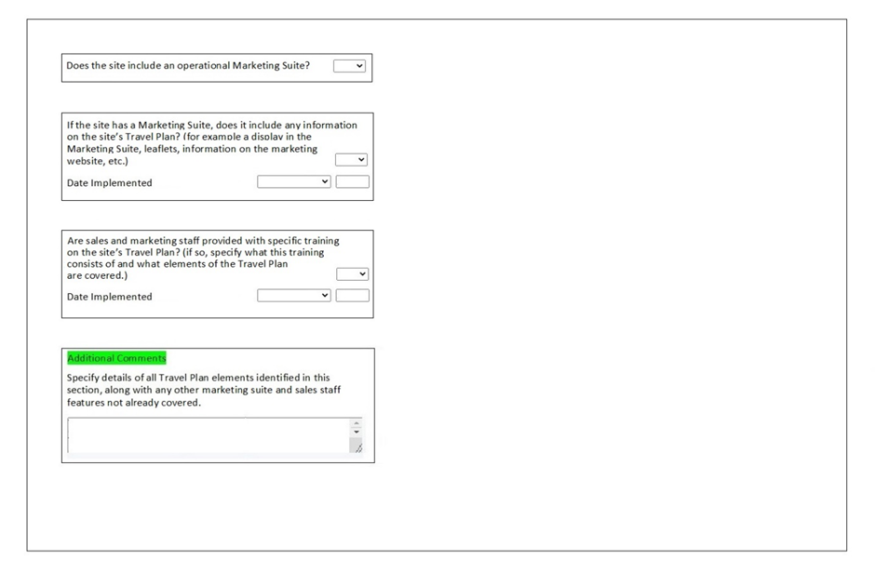
RESIDENTIAL SAM SURVEYS: MARKETING SUITE & SALES STAFF
Notes:
There is also a whole new sub-section for residential sites called Marketing Suite & Sales Staff. This was added as a direct result of an individual Working Group suggestion and includes detail on travel plan information provided within marketing suites and training of marketing suite staff with regards to the travel plan.

Slide 21
NEW TRAVEL PLAN SECTION
Non-Residential developments from 2023 onwards
Screen layouts of revised Travel Plan sub-sections
Notes:
We can now look at the new screen layouts for non-residential developments.

Slide 22
NON-RESIDENTIAL SAM SURVEYS: MAIN DETAILS
Notes:
Here is the Main Details sub-section for non-residential sites. Note that it is identical to residential sites.

Slide 23

NON-RESIDENTIAL SAM SURVEYS: TRAVEL PLAN OBJECTIVES & TARGETS
Notes:
The Travel Plan Objectives & Targets sub-section for non-residential sites is almost identical to residential sites, but note that the travel plan targets are tailored towards non-residential developments.

Slide 24
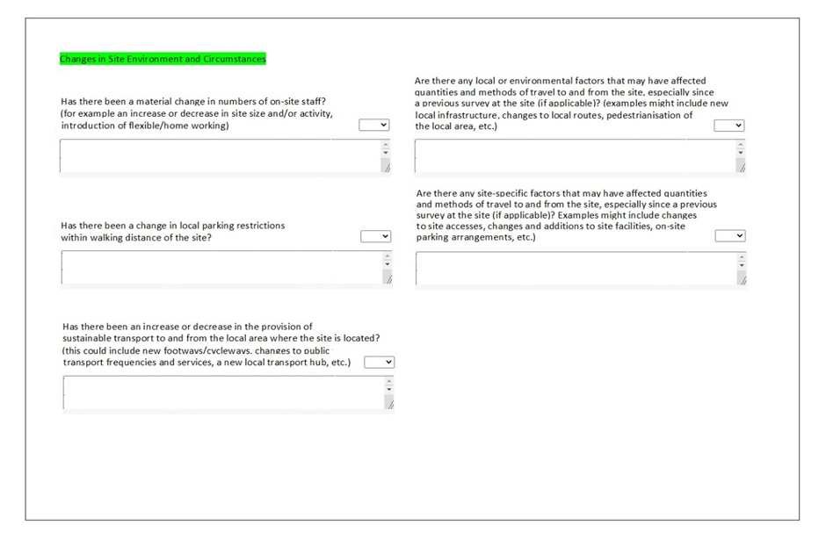
NON-RESIDENTIAL SAM SURVEYS: CHANGES & SITE ENVIRONMENT & CIRCUMSTANCES
Notes:
The Changes in Site Environment & Circumstances sub-section for non-residential sites is also similar to the corresponding residential version, but with subtle differences. For example, there is a question that asks about material change in numbers of on-site staff and mentions flexible and home working arrangements.

Slide 25
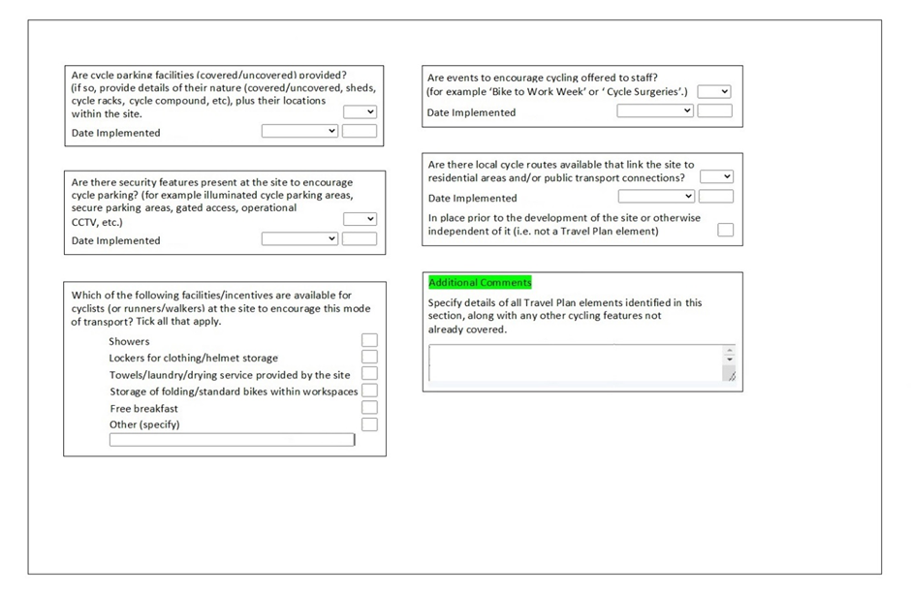
NON-RESIDENTIAL SAM SURVEYS: CYCLING
Notes:
The Cycling sub-section for non-residential sites is significant different now to the corresponding residential version. For example, there is a tick box section on facilities and incentives for staff, including showers, staff lockers, bike storage areas within workspaces, etc. There is also a question on cycling encouragement such as “Bike to Work Week”.

Slide 26
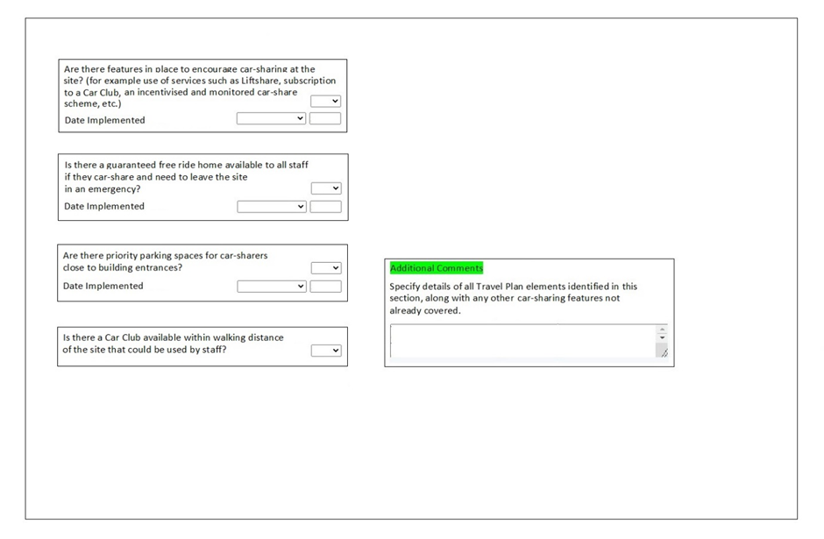
NON-RESIDENTIAL SAM SURVEYS: CAR SHARING
Notes:
The Car-Sharing sub-section for non-residential sites also differs to residential sites in that there is mention of features to encourage car sharing and free ride home services for emergencies.

Slide 27
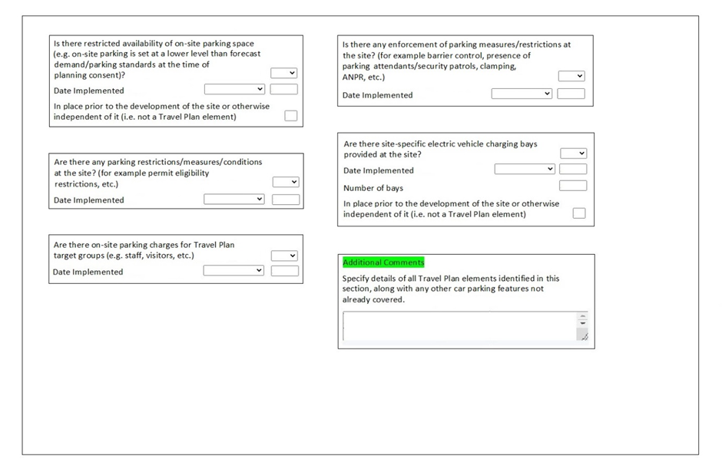
NON-RESIDENTIAL SAM SURVEYS: CAR PARKING
Notes:
The Car Parking sub-section for non-residential sites also includes new information on specific electric vehicle charging bays, with the text of other questions more tailored towards non-residential development types.

Slide 28
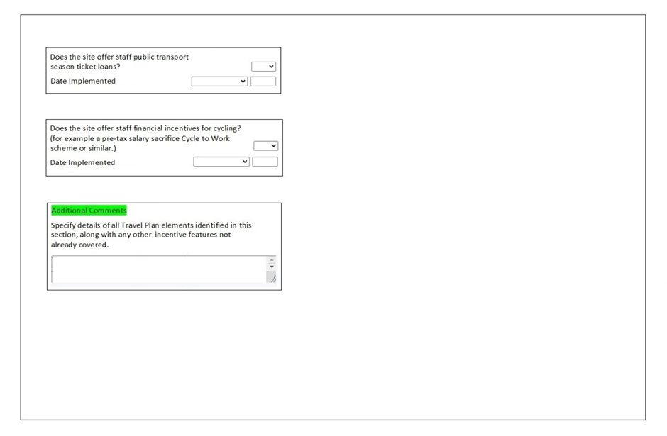
NON-RESIDENTIAL SAM SURVEYS: INCENTIVES
Notes:
The Incentives sub-section for non-residential sites mentions season ticket loans for staff plus financial incentives for cycling (for example a pre-tax salary sacrifice Cycle to Work scheme or similar).

Slide 29
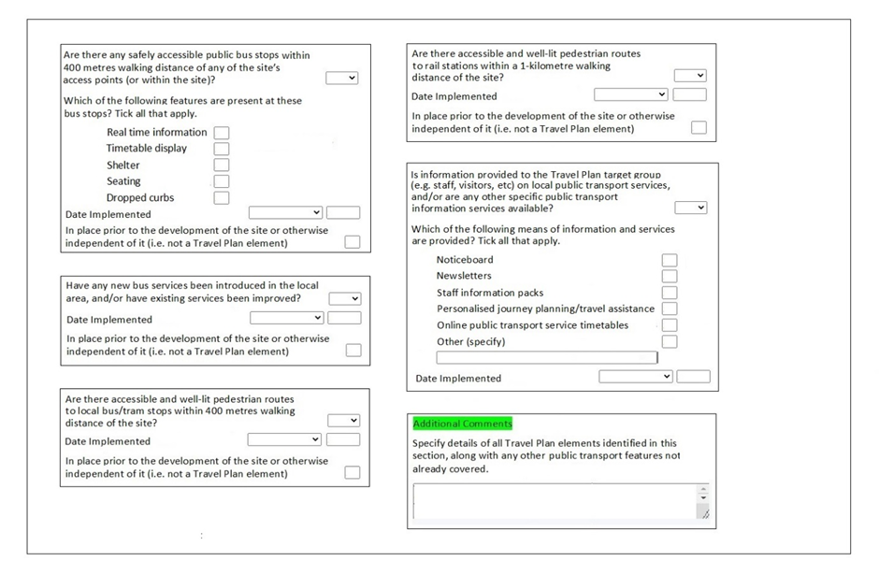
NON-RESIDENTIAL SAM SURVEYS: PUBLIC TRANSPORT
Notes:
Like the residential version, the Public Transport sub-section for non-residential sites has been significantly overhauled, and includes information on public transport information provided to employees by way of noticeboards, newsletters, staff information packs, etc. Again, this is a common feature we have found within non-residential travel plans over the years, and we have now refined this to make the information more relevant and better structured.

Slide 30
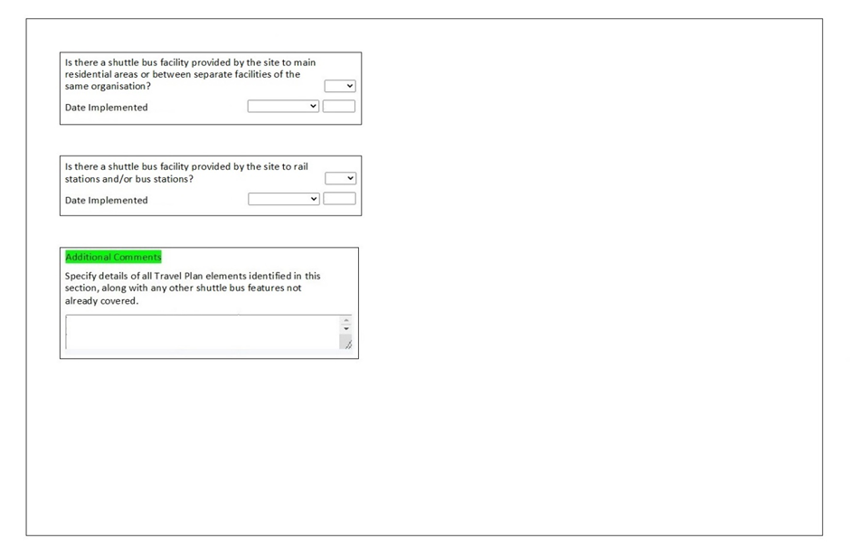
NON-RESIDENTIAL SAM SURVEYS: SHUTTLE BUS
Notes:
Whereas for residential sites the Shuttle Bus sub-section has now been removed, it remains for non-residential sites, and some of the text has been changed to relate to shuttle buses between two facilities of the same organisation.

Slide 31
TRAVEL PLAN REVISIONS:
IMPLEMENTATION TIMELINE
December 2022: TRICS Data Collection Form updated.
March 2023: TRICS Database System updated.
March-June 2023: First SAM surveys undertaken using new Travel Plan format.
June 2023: Potential first surveys in new format included in TRICS system update.
Notes:
I can conclude this presentation by providing the timeline for the implementation of these changes. In December 2022, the TRICS data collection form will be updated, so that it is ready for all new SAM surveys in 2023. In March 2023, the TRICS system development will be completed so that the database can accept the new Travel Plan section data in its revised format. The first SAM surveys using this new format will be undertaken during the Spring 2023 March to June window, and by June 2023 the first surveys in the new format will potentially be added to the TRICS system update at the end of that month.

